Slide 1
Introduction to Islam
Mustafa Hegazy
Assistant Imam At The ICCI

Slide 2
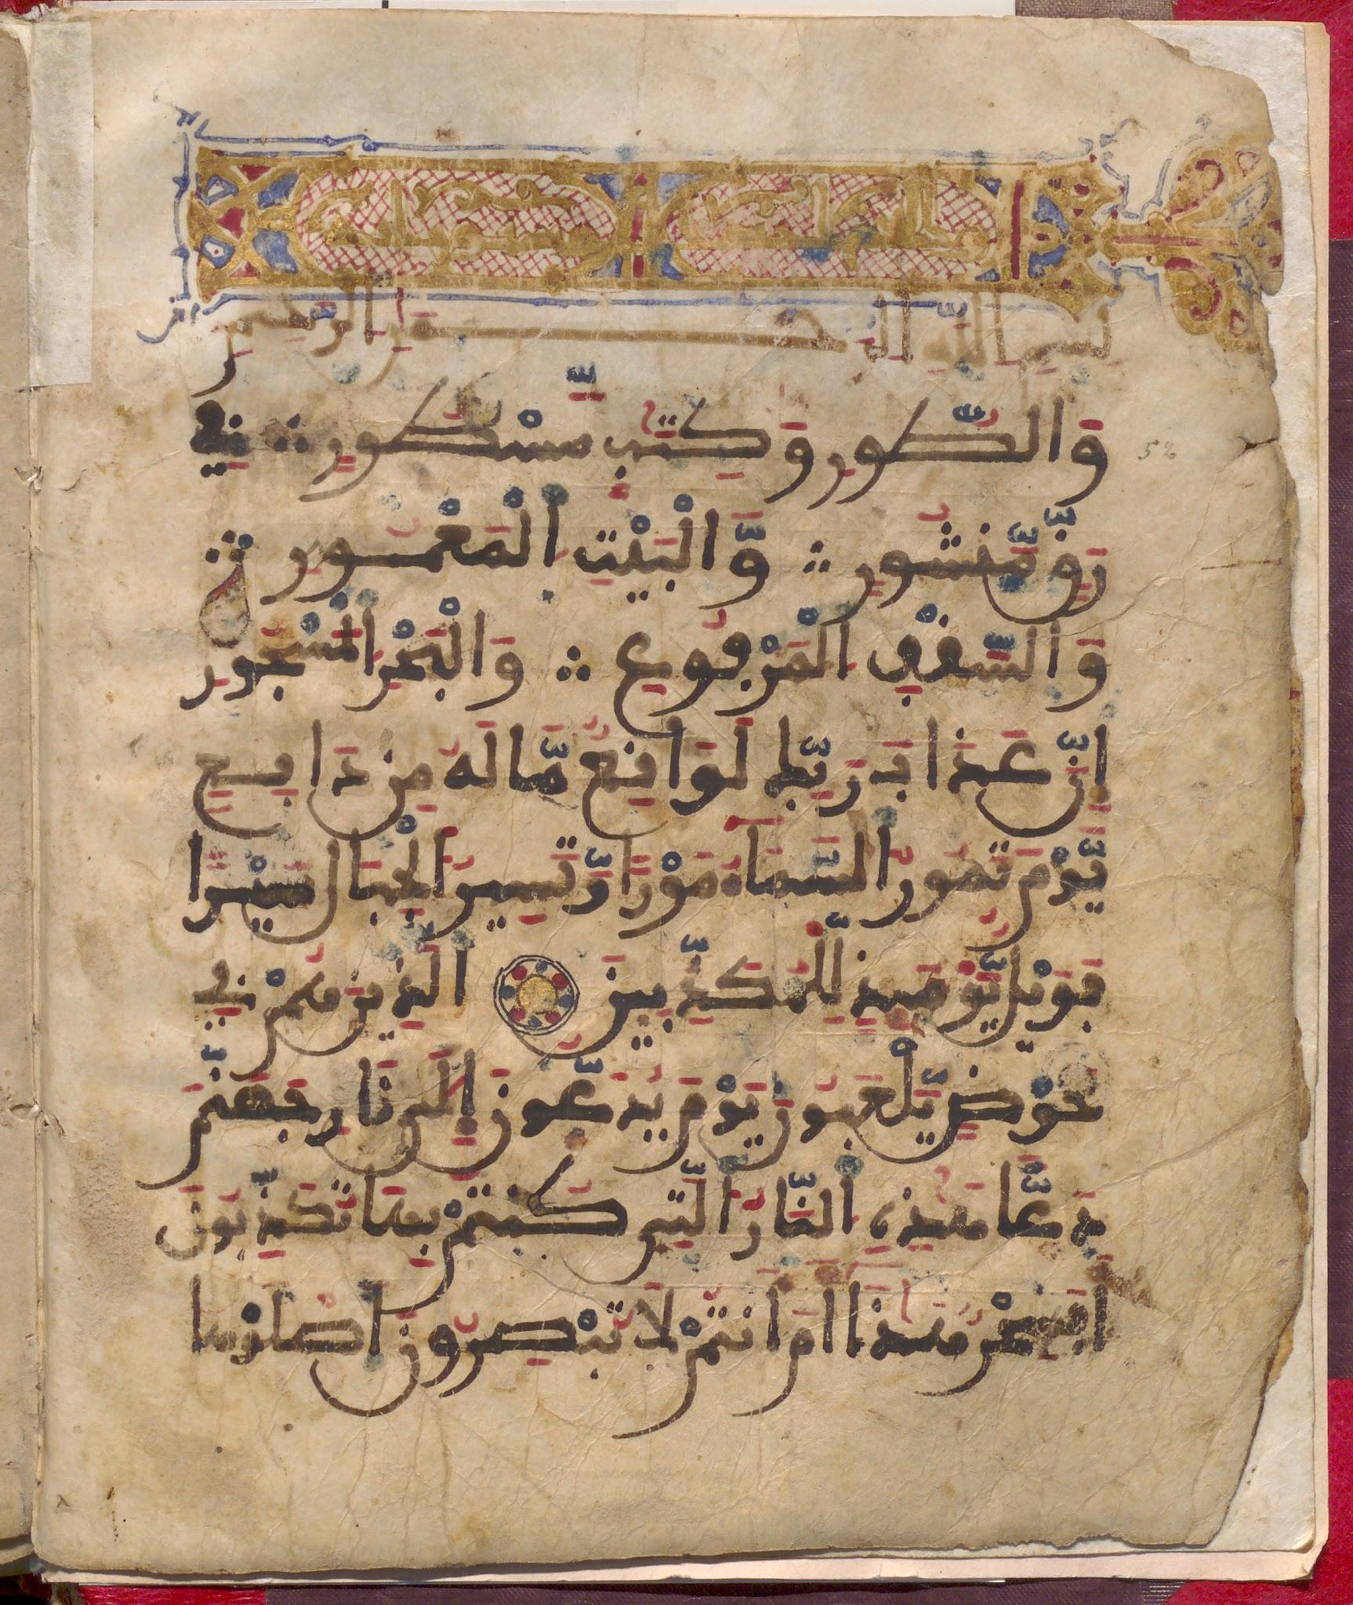
Our Topics Today:
The Fundamentals of Islam:
What does the word Islam means.
Geographical Distribution.
The continuity of the message
The Oneness of God
The Quran
Prophet M
The Holy Places for Muslims
Islamic way of life
Muslim Belief
Muslim Worship

Slide 3
Islam ?
The word “Islam” is an Arabic word which means “submission to the will of God”
comes from the same root as the Arabic word “salam”, which means “peace”
the religion of Islam teaches that in order to achieve true peace of mind and surety of heart, one must submit to God and live according to His Divinely revealed Law.

Slide 4
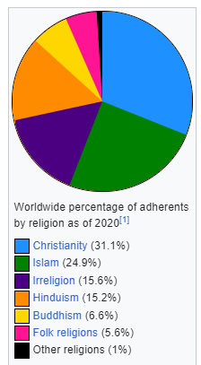
Geographical Distribution:
Islam constitute the world's second largest religious group.
In terms of percentage and worldwide spread, Islam is the fastest-growing major religion in the world.
Most Muslims are either of two denominations: Sunni (87–90%, roughly 1.7 billion people)[6] or Shia (10–13%, roughly 180–230 million people).

Slide 5
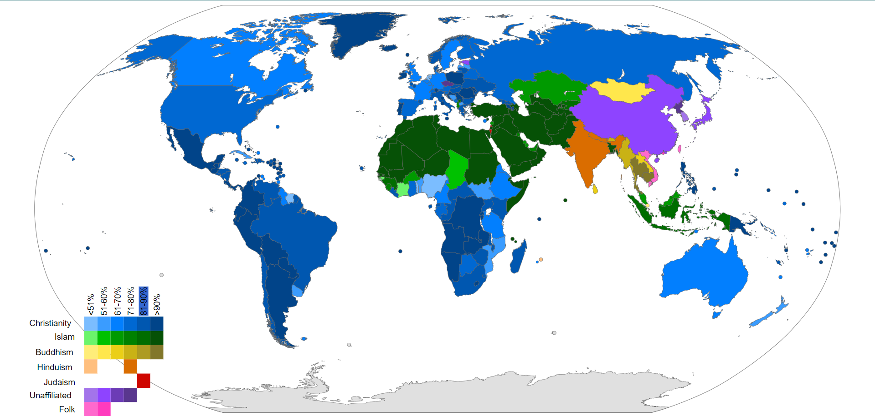
Map of major denominations and religions
50 Muslim-majority countries
62% of the world's Muslims live in the Asia-Pacific region (from Turkey to Indonesia)
Country No 1 ?
Country No 2 ?
Country No 3 ?
Country No 4 ?
Arab Muslim Countries % ?

Slide 6
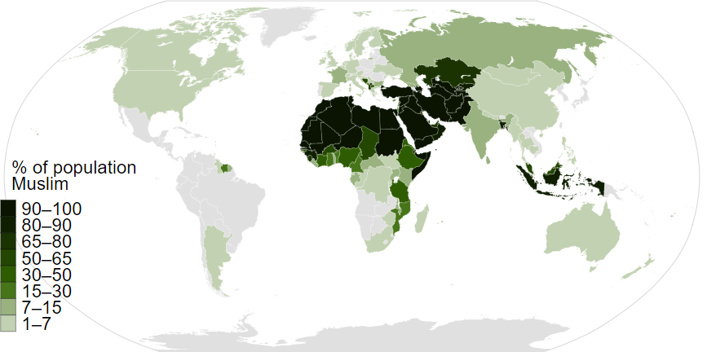

Slide 7
It is the Same message ?
Islam is not a new religion.
Continuity of the Message.
Prophet Muhammad is not the founder of a new religion
The way of Islam is the same as the way of the prophet Abraham.

Slide 8
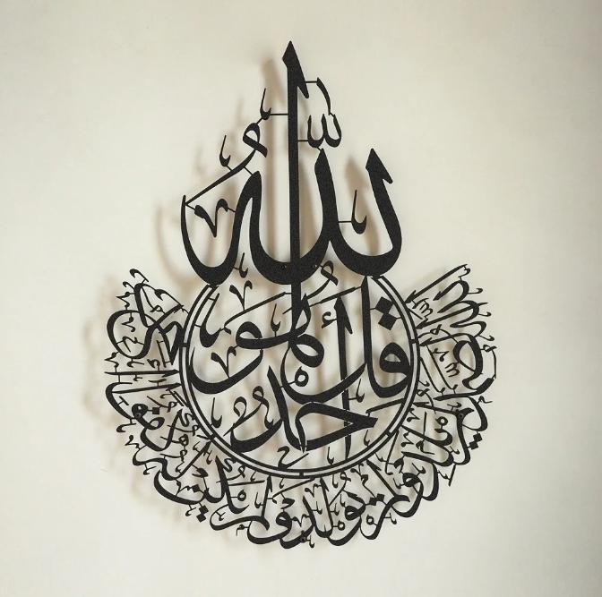
The foundation of the Islamic faith is the belief in the Oneness of Almighty God - the God of Abraham, Noah, Moses and Jesus.
All prayers and worship should be exclusively for God.
No ambiguity in divinity - God is God and man is man.
Muslims believe that God is Loving, Compassionate and Merciful, and that He is concerned with the daily affairs of human beings.

Slide 9
Allah ?
Muslims reject the Christian belief that God is a Trinity, not only because the Quran rejects it, but also because if this was God’s true nature, He would have clearly revealed it to Abraham, Noah, Jesus and all of the other prophets.
What was the religion of prophet Abraham ?

Slide 10
The Miracle of Islam
Al-Qur’an:
Style and eloquence .
Preserved.
Teachings and rules.
Spiritual Impact.
Scientific .

Slide 11
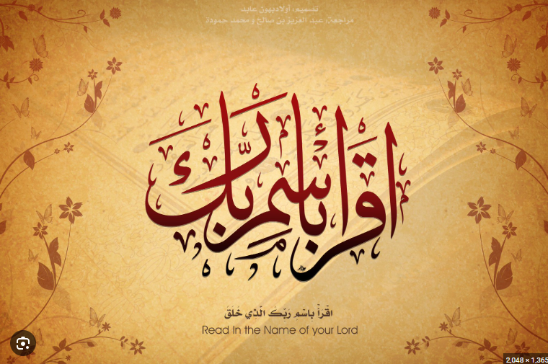
The Miracle of Islam
Al-Qur’an:
The Primary source of our religion.
Literally , the word of God.
The Arabic word “Al-Quran” literally means “the recitation”.
Completed within the life of Prophet Muhammad
Speaks to your mind , asks you to think and to search for the truth
The very first words descended on Prophet Muhammad was :

Slide 12
Al-Qur’an:
Its content:
Allah
Nature & Universe.
Stories.
The Day of Judgment .
Teachings.

Slide 13
The Prophet M. Pbuh:
The Last messenger .
His sayings and teachings was preserved in what is called Hadeeth – the second source of Islam.
Not divine in any way :
وَما مُحَمَّدٌ إِلّا رَسولٌ قَد خَلَت مِن قَبلِهِ الرُّسُلُ ۚ
Muḥammad is but an apostle; [other] apostles have passed before him.
Living example of God’s revelation .

Slide 14
The Holy Places

Slide 15
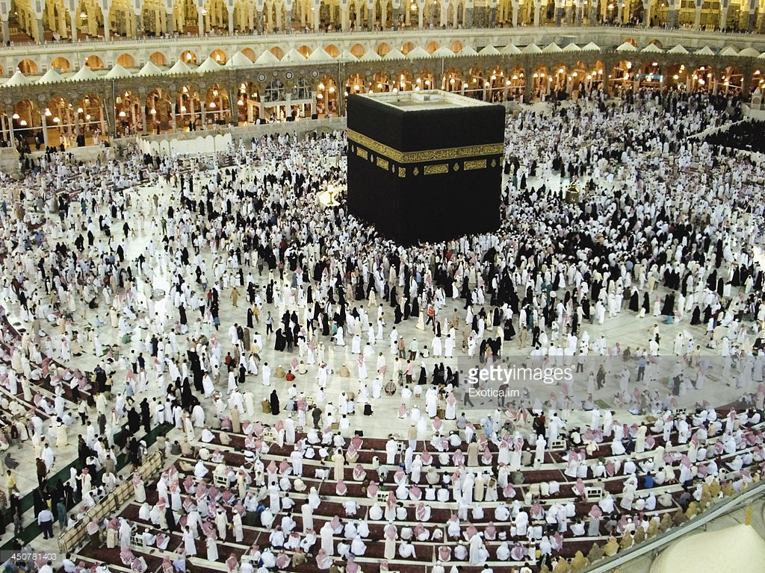
1.Makkah

Slide 16
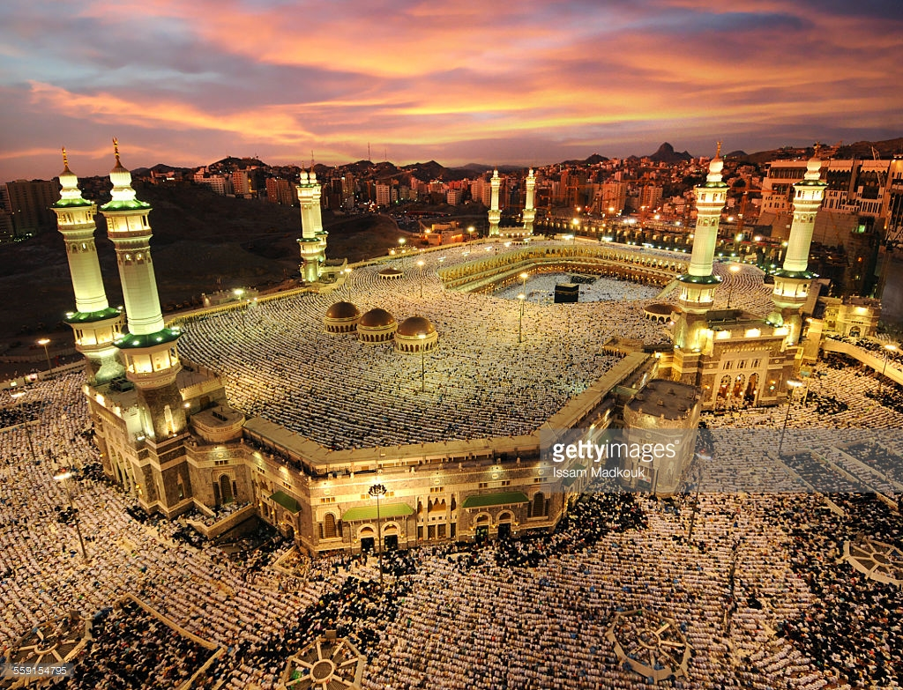

Slide 17
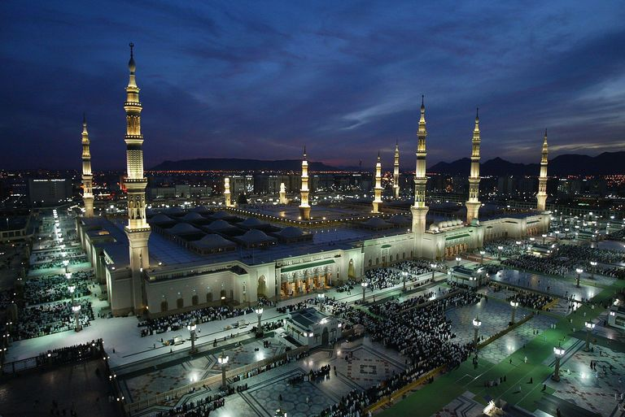
2.Al Madina Al Munawra

Slide 18
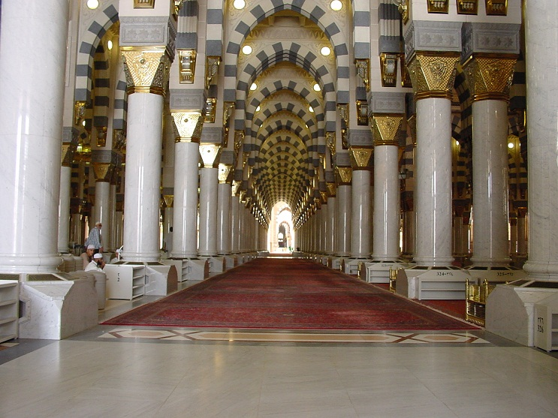

Slide 19
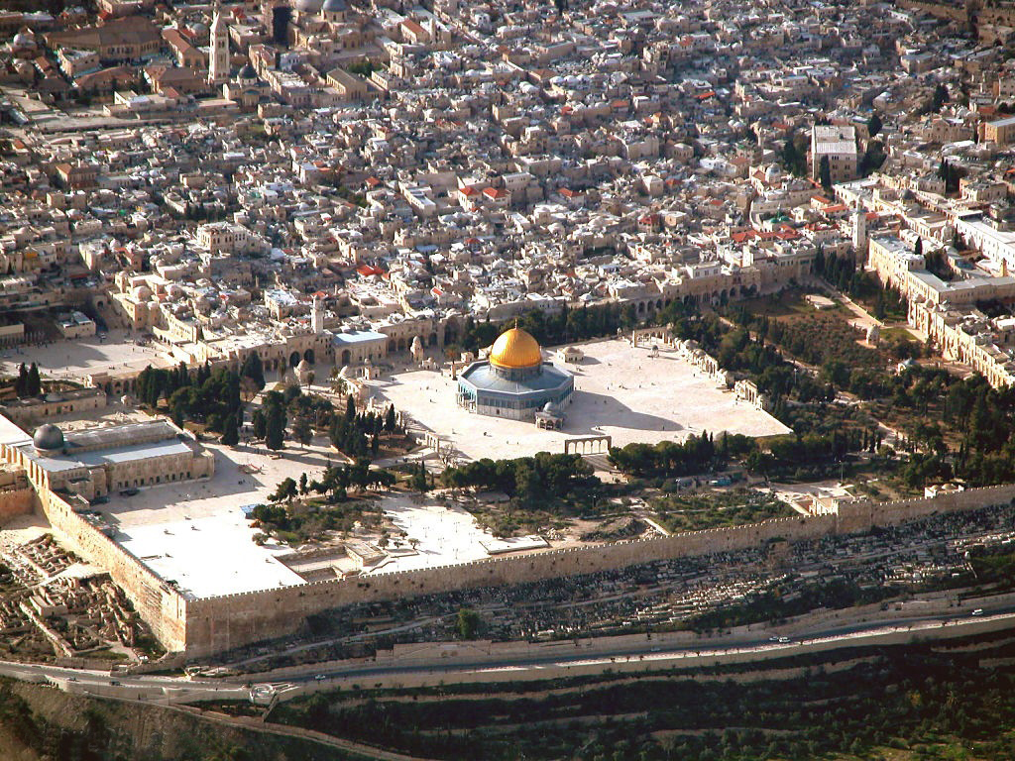
3.Al-Aqsa Mosque

Slide 20
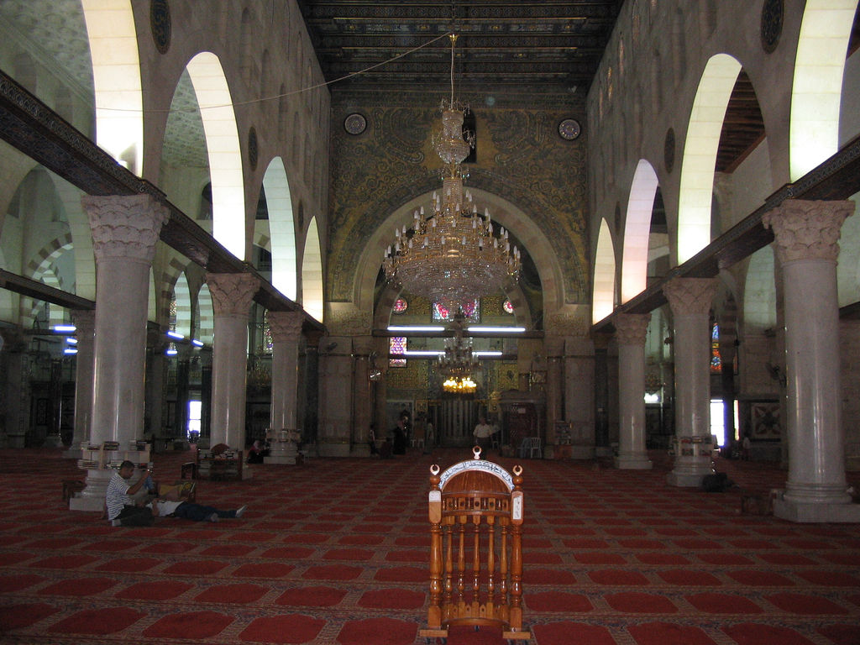

Slide 21
Muslim Belief and Worship

Slide 22
The six Articles of Faith :
Faith in Unity of God .
Faith in Angels.
Faith in Books of revelation .
Faith in the Hereafter.
Faith in Prophets .
Faith in destiny/divine Decree

Slide 23
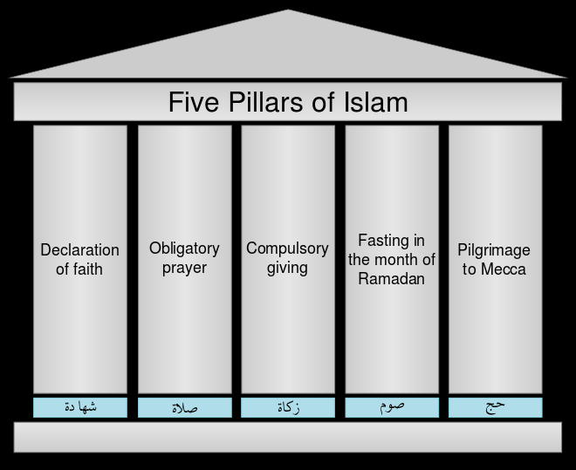
Muslim Belief and Worship

Slide 24
The Muslim concept of worship is very broad.
Believe with your heart , declare with your tongue and act with your limbs .
The Objectives of the acts of worship is first to strengthen a Muslim's faith and show complete obedience to God, and second to correct his manners.

Slide 25
1.Testimony of Faith-Al shahaadah
bear witness that there is no diety except Allah, and I bear witness that Muhammad is the messenger of Allah.
Ash-hadu an laa ilaaha il Allah, wa ash-hadu anna Muhammad ar-Rasuul Allah.
A person who understands this declaration, recites it with sincerity, and lives according to its teachings is a Muslim.

Slide 26
2.AsSalah:
Five compulsory Prayers everyday.
Prayer in Islam is a direct link between the worshipper and God.
Prayers are performed at dawn, noon, mid-afternoon, sunset, and night.
A Muslim may pray almost anywhere, such as in fields, offices, schools, factories, or hospitals.
Friday is a special day of congregational prayer that takes place at midday.

Slide 27
3.AzZakah - Alms Giving :
Giving zakat means ‘giving a specified percentage on certain properties to certain classes of needy people.
This ensured redistribution of wealth to those who have to those that do not have their basic needs met.
Zakat means to purify and to grow.
everything we have is a trust from God.
A person may also give as much as he or she pleases as voluntary alms or charity.

Slide 28
4.Fasting - AsSawoum :
fast from dawn until sundown, abstaining from food, drink, and sexual activity.
a method of spiritual self-purification
Create sympathy with those who go hungry

Slide 29
5.Pilgrimage- Al Hajj :
An obligation once in a lifetime for the capable.
About two million people go to Makkah each year from every corner of the globe.
Male pilgrims wear special simple clothes which strip away distinctions of class and culture so that all stand equal before God.

Slide 30
Thank You
Questions

